Slide 1
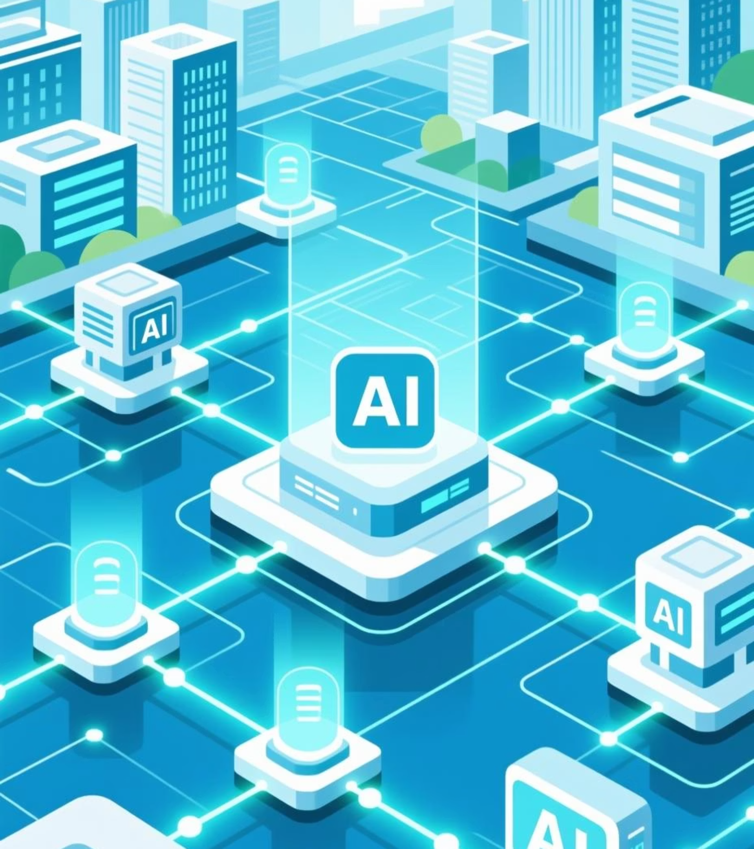
Yukawa.AI – Building the Future of Unified Enterprise Intelligence
"Yukawa.AI will unite data, AI, and agents into one intelligent ecosystem."

Slide 2

Vision for Yukawa.AI
Building the Future of Unified Enterprise Intelligence
Unified Enterprise Data & AI Platform
Top Databricks Partner & Cloud-AI Innovator
Agentic AI Consultancy
Managed, centralized, and governed foundation
Harnessing cross-domain data & AI experience
All enterprise data unified → single source of truth
Lakehouse & Delta architectures, best-in-class governance
Intelligent Agents automating and optimizing enterprise workflows
Enabler for analytics, AI, and automation
Cloud-native, scalable, multi-cloud ready
Unity Catalog, MLOps, and continuous optimization
Generative + Structured data fusion
Strategic Pillars & Differentiation
why Yukawa.AI is you best partner for Data and AI Vision and Implementation.
Pillar 1 – Unified Enterprise Data & AI Platform
Pillar 2 – Agentic Edge in AI Implementation
Enterprise-wide, governed, and trusted data foundation
Agentic AI – adaptive, context-aware, decision-driven systems
Self-service analytics, forecasting, and intelligent automation
LLMs, Vector DBs, LangChain, LlamaIndex integration
Built on Databricks + Cloud-native stack (AWS, GCP, Azure)
Continuous learning from enterprise + external data
Standard Best Practices (Our DNA)
☁ Cloud Native | 📊 Data First | 🧩 Enterprise Governance | 🤖 AI Native | 🕹 Agentic by Design
"Data-Driven. AI-Native. Agentic by Design."

